Slide 1
Graph-based Mining of In-the-Wild, Fine-grained, Semantic Code Change Patterns
Hoan Nguyen
Tien Nguyen
Danny Dig
Son Nguyen
Hieu Tran
Michael Hilton

Slide 2


Repetitiveness of Software
Repetitive Code
Parsing Java source file
Parsing Java source file
JDT
java.util
JDT
java.util
Tree traversal
Tree traversal
Thanos
Nguyen

Slide 3
Repetitiveness of Software
Repetitive Code
Parsing Java source file
Parsing Java source file
JDT
java.util
JDT
java.util
Tree traversal
Tree traversal
Thanos
Nguyen

Slide 4
Repetitiveness of Software
Repetitive Change
Parsing Java source file
Parsing Java source file
JDT
java.util
JDT
java.util
Tree traversal
Tree traversal
Thanos
Nguyen

Slide 5
Example of Repeated Code Changes
Adapting a new language feature JDK 1.4 → JDK 1.5
Before
After
1 – for (Iterator<Element> it = o.getElements().iterator(); it.hasNext();)
2 – myElms.add (it.next());____________________________
1 + for (Element elm : o.getElements())_______________
2 + myElms.add(elm) ;______________________
JDK 1.4
JDK 1.5
Code refactoring
Before
After
1 – List <HighlightInfo> list = new ArrayList <>();________________
2 – for ( HighlightInfo info : highlights1 )_______________________
3 – list.add (info) ;__________________________________
1 + List <HighlightInfo> result = new ArrayList <>();______
2 + result.addAll (highlights1);_______________________

Slide 6
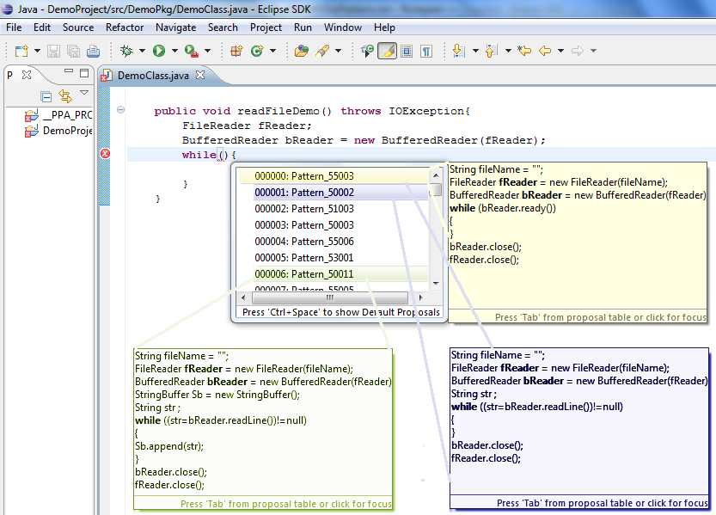
Repeated Changes and Applications
Change/fix recommendation
Code auto-completion

Slide 7
Repeated Changes and Applications
Change/fix recommendation
Code auto-completion
Language migration
Refactoring support
...
-------
-------
--------
...
extract
method
...
-------
-------
--------
...
-------
-------
--------
...
-------
-------
--------
...

Slide 8
Challenges of Capturing Change Semantics
Syntactically un-changed program elements could carry the semantic context of change
Before
After
1
2
3 File f = new File ("Output.txt"); _______________________
4 FileOutputStream s = new FileOutputStream (f); _________
5 i = str.indexOf ("pattern",start); ______________________
1+ if (start <= 0) ____________________________________
2+ return; __________________________________
3* File of = new File ("Output.txt");______________________
4* FileOutputStream outStream = new FileOutputStream (of);
5 i = str.indexOf ("pattern", start);____
Notes:
However

Slide 9
Challenges of Capturing Change Semantics
Syntactically un-changed program elements could carry the semantic context of change
Not changed,
a part of the pattern
Before
After
1
2
3 File f = new File ("Output.txt"); _______________________
4 FileOutputStream s = new FileOutputStream (f); _________
5 i = str.indexOf ("pattern",start); ______________________
1+ if (start <= 0) ____________________________________
2+ return; __________________________________
3* File of = new File ("Output.txt");______________________
4* FileOutputStream outStream = new FileOutputStream (of);
5 i = str.indexOf ("pattern", start);____
Notes:
However
adds a negative check on the second argument of a call at line 5

Slide 10
Challenges of Capturing Change Semantics
Syntactically un-changed program elements could carry the semantic context of change
Include the unchanged elements with the changes
in a semantic change pattern
Before
After
1
2
3 File f = new File ("Output.txt"); _______________________
4 FileOutputStream s = new FileOutputStream (f); _________
5 i = str.indexOf ("pattern",start); ______________________
1+ if (start <= 0) ____________________________________
2+ return; __________________________________
3* File of = new File ("Output.txt");______________________
4* FileOutputStream outStream = new FileOutputStream (of);
5 i = str.indexOf ("pattern", start); ___________________ __

Slide 11
Challenges of Capturing Change Semantics
Syntactically un-changed program elements could carry the semantic context of change
Elements of a semantic change could be non-contiguous in the code
Before
After
1
2
3 File f = new File ("Output.txt"); _______________________
4 FileOutputStream s = new FileOutputStream (f); _________
5 i = str.indexOf ("pattern",start); ______________________
1+ if (start <= 0) ____________________________________
2+ return; __________________________________
3* File of = new File ("Output.txt");______________________
4* FileOutputStream outStream = new FileOutputStream (of);
5 i = str.indexOf ("pattern", start); ___________________ __
Notes:
Also in this example

Slide 12
Challenges of Capturing Change Semantics
Syntactically un-changed program elements could carry the semantic context of change
Elements of a semantic change could be non-contiguous in the code
Should be able to connect
the fragmented changes involving a change pattern
Before
After
1
2
3 File f = new File ("Output.txt"); _______________________
4 FileOutputStream s = new FileOutputStream (f); _________
5 i = str.indexOf ("pattern",start); ______________________
1+ if (start <= 0) ____________________________________
2+ return; __________________________________
3* File of = new File ("Output.txt");_____________________
4* FileOutputStream outStream =new FileOutputStream (of);
5 i = str.indexOf ("pattern",start);______________________
Notes:
Notice that
The changes on unrelated parts at lines 3-4 make noise for capturing …

Slide 13
Challenges of Capturing Change Semantics
Different semantic changes could have the same syntactic change representation
Before
After
1
2
...
5 i = str.indexOf ("pattern",start); ______________________
1+ if (start <= 0) _______________________________
2+ return; ______________________________
…
5 i = str.indexOf ("pattern",start);____________________
Notes:
Additionally

Slide 14
Challenges of Capturing Change Semantics
Different semantic changes could have the same syntactic change representation
After
Check the 2nd argument
Before
1
2
...
5 i = str.indexOf ("pattern",start); ______________________
1+ if (start <= 0) _______________________________
2+ return; ______________________________
…
5 i = str.indexOf ("pattern",start);____________________
Notes:
Additionally

Slide 15
Challenges of Capturing Change Semantics
Different semantic changes could have the same syntactic change representation
Before
After
1
2
...
5 i = str.indexOf ("pattern",start);
1+ if (start <= 0) _______________________________
2+ return; ______________________________
…
5 i = str.indexOf ("pattern",start);____________________
Check the return value
1 i = str.indexOf ("pattern", start);
2
3 3
4 sub = str .substring( i ) ; ______________________
1 i = str.indexOf ("pattern", start);__________________
2+ if (i <= 0) __________________________________
3+ return; ______________________________
4 sub = str .substring( i ) ; ________________________
Notes:
Additionally

Slide 16
Challenges of Capturing Change Semantics
Different semantic changes could have the same syntactic change representation
Before
After
1
2
...
5 i = str.indexOf ("pattern",start); ______________________
1+ if (start <= 0) _______________________________
2+ return; ______________________________
…
5 i = str.indexOf ("pattern",start);____________________
SAME syntactical change
1 i = str.indexOf ("pattern", start);
2
3 3
4 sub = str .substring( i ) ; ______________________
1 i = str.indexOf ("pattern", start);
2+ if (i <= 0) __________________________________
3+ return; ______________________________
4 sub = str .substring( i ) ; ________________________
Notes:
Additionally

Slide 17
Challenges of Capturing Change Semantics
Should be able to distinguish
the patterns having the same syntactic representation,
but different meanings
Different semantic changes could have the same syntactic change representation
Before
After
1
2
...
5 i = str.indexOf ("pattern",start); ______________________
1+ if (start <= 0) _______________________________
2+ return; ______________________________
…
5 i = str.indexOf ("pattern",start);____________________
DIFFERENT semantic changes
1 i = str.indexOf ("pattern", start);
2
3 3
4 sub = str .substring( i ) ; ______________________
1 i = str.indexOf ("pattern", start); _________________
2+ if (i <= 0) __________________________________
3+ return; ______________________________
4 sub = str .substring( i ) ; ________________________
Notes:
Additionally

Slide 18
CPatMiner
Uses program dependence graph to capture dependencies between program elements involved in atomic changes, and
Infers semantic change patterns using frequent sub-graph mining
Notes:
To overcome these above challenges, we propose

Slide 19

Fine-grained Code Representation
getElements()
recv
iterator()
def
Operation
Iterator
Data
recv
for (Iterator<Element> it = o.getElements().iterator(); it.hasNext();)
myElms.add (it.next);
hasNext()
Control
cond
edge type
For
control
control
next()
recv
para
add()
Notes:
Particularly
Fine-grained PDG

Slide 20
Fine-grained Code Representation
getElements()
recv
iterator()
def
Operation
Iterator
Data
recv
for (Iterator<Element> it = o.getElements().iterator(); it.hasNext();)
myElms.add (it.next);
hasNext()
Control
cond
edge type
For
control
control
next()
recv
para
add()
Notes:
In the graph
represent variables, field accesses and constants

Slide 21
Fine-grained Code Representation
getElements()
recv
iterator()
def
Operation
Iterator
Data
recv
for (Iterator<Element> it = o.getElements().iterator(); it.hasNext();)
myElms.add (it.next());
hasNext()
Control
cond
edge type
For
control
control
next()
recv
para
add()
Notes:
represent operations on data
Such as

Slide 22
Fine-grained Code Representation
getElements()
recv
iterator()
def
Operation
Iterator
Data
recv
for (Iterator<Element> it = o.getElements().iterator(); it.hasNext();)
myElms.add (it.next);
hasNext()
Control
cond
edge type
For
control
control
next()
recv
para
add()
Notes:
or a control statement: for, if, while

Slide 23
Fine-grained Code Representation
getElements()
recv
iterator()
def
Operation
Iterator
Data
recv
for (Iterator<Element> it = o.getElements().iterator(); it.hasNext();)
myElms.add (it.next);
hasNext()
Control
cond
edge type
For
control
control
next()
recv
para
add()
Notes:
An edge coming into a node represents the data flow between nodes
Or the control relation between the statement/operation and control node

Slide 24
Fine-grained Code Representation
Before
After
for (Iterator<Element> it = o.getElements().iterator(); it.hasNext();)
myElms.add (it.next);
for (Element elm : o.getElements())__ myElms.add(elm);_______________________
getElements()
getElements()
recv
iterator()
def
def
Iterator
Element
cond
recv
cond
hasNext()
cond
para
Enhanced For
para
For
control
control
next()
para
control
recv
add()
add()
Notes:
For a change from old version to a new one,

Slide 25
Fine-grained Change Representation
Before
After
1– for (Iterator<Element> it = o.getElements().iterator(); it.hasNext();)
2– myElms.add (it.next());___________________________
1+ for (Element elm : o.getElements())______
2+ myElms.add(elm);_____________
getElements()
getElements()
recv
map
iterator()
def
def
Iterator
Element
cond
recv
cond
hasNext()
cond
para
Enhanced For
para
For
control
control
next()
para
control
recv
map
add()
add()
Notes:
Fine-grained change graph
Unchange nodes are connected using edges annotated map

Slide 26
Fine-grained Change Representation
Before
After
1– for (Iterator<Element> it = o.getElements().iterator(); it.hasNext();)
2– myElms.add (it.next());___________________________
1+ for (Element elm : o.getElements())______
2+ myElms.add(elm);_____________
getElements()
getElements()
recv
map
iterator()
def
def
Iterator
Element
cond
recv
Deleted
cond
hasNext()
cond
Added
para
Enhanced For
para
For
control
control
next()
para
control
recv
map
add()
add()
Notes:
labeled added/deleted nodes

Slide 27
Fine-grained Change Graph Pattern Mining
A
A’
A
A’
Mining frequent subgraphs
B
C
B
C
Code
changes
Extracting change graphs
A
A’
B
C
A
A’
A
A’
Pattern
B
C
B
C

Slide 28
Fine-grained Change Graph Pattern Mining
Backing up for the algorithm

Slide 29
Mining Approach Components
Comparing (sub)graphs
Generating frequent subgraphs
Challenges
Graph isomorphism is computationally expensive
There are exponentially many subgraphs

Slide 30
Solutions
Solutions
Using vector-based signature instead of graph isomorphism [Nguyen et al. FASE’09]
Mining patterns from small to large, generate candidates of large size from patterns of small size
Extending subgraphs greedily to avoid combinatorial explosion

Slide 31
Comparing Graphs
A
B
B
C
C
A
A
A
B
B

Slide 32

Comparing Graphs
A
B
B
C
C
A
A
A
B
B
Feature | A | B | C | A→A | A→B | A→C | B→A | C→B
Count | 2 | 2 | 1 | 1 | 2 | 1 | 1 | 1
Feature | A | B | C | A→A | A→B | A→C | B→A | C→B
Count | 2 | 2 | 1 | 1 | 2 | 1 | 1 | 1
Comparing Graphs ≈ Comparing Vectors
[Nguyen et al. – Fundamental Approaches to Software Engineering 2009]

Slide 33
Comparing Graphs
A
B
C
A
B
Feature | A | B | C
Count | 2 | 2 | 1

Slide 34
Comparing Graphs
A
B
C
A
B
Feature | A | B | C | A→A | A→B | A→C | B→A | C→B
Count | 2 | 2 | 1 | 1 | 2 | 1 | 1 | 1
2-path

Slide 35
Comparing Graphs
A
B
C
A
B
Feature | A | B | C | A→A | A→B | A→C | B→A | C→B | ABA | AAB | ACB | BAB
Count | 2 | 2 | 1 | 1 | 2 | 1 | 1 | 1 | 1 | 1 | 1 | 1
3-path

Slide 36
Generating Frequent Subgraphs
Larger frequent subgraphs contain smaller frequent subgraphs

Slide 37
Generating Frequent Subgraphs
A
A
B
A
A
A
C
B
B
B
B
A
C
C
B
C
C
Graph
1
Graph
2
Graph 3
Graph 4
37

Slide 38
Starting with pattern of size 1
A
A
B
A
A
A
A
C
B
B
B
B
B
A
C
C
C
B
C
C
Pattern
of size 1
Graph
1
Graph
2
Graph 3
Graph 4
38

Slide 39
Extending occurrences of size 1 to candidates of size 2
A
A
B
A
A
A
A
C
B
B
B
B
B
A
C
C
C
B
C
C
Pattern
of size 2
Graph
1
Graph
2
Graph 3
Graph 4
39

Slide 40
Extending occurrences of size 2 to candidates of size 3
A
A
B
A
A
A
A
C
B
B
B
B
B
A
C
C
C
B
C
C
Pattern
of size 3
Graph
1
Graph
2
Graph 3
Graph 4
non-overlapped
overlapped
40

Slide 41
Generating Frequent Subgraphs
Extending subgraphs greedily to avoid combinatorial explosion

Slide 42




Empirical Evaluation
1
Meaningfulness
2
Maintenance Activities
3
Comparison with syntax-based approach
4
Commonality of Patterns
5
Temporal Distribution

Slide 43
Meaningfulness (RQ1)
Surveying +450 real developers
Q1: Is the change at these lines similar to another change in the past?
Q2: Can you briefly describe the change and why you made it?
Q3: Can you give a name for the change?
Q4: Would you like to have this change automated by a tool?
Dataset of 300K fresh commits from 5.8K highly rated projects

Slide 44
Survey Results
Q1 Is the highlighted change at these lines similar to another in the past?
Yes | No | Not sure |  | No answer
69% | 22% | 6% |  | 3%
Q3 Can you give it a name?
Yes | No |  |  | No answer
79% | 18% |  |  | 3%
Q4 Would you like to have this change automated by a tool?
Yes | No | Not sure | Already Automated | No answer
44% | 34% | 9% | 10% | 3%

Slide 45
Survey Results
CPatMiner is able to detect meaningful patterns
Q1 Is the highlighted change at these lines similar to another in the past?
Yes | No | Not sure |  | No answer
69% | 22% | 6% |  | 3%
Q3 Can you give it a name?
Yes | No |  |  | No answer
79% | 18% |  |  | 3%
Q4 Would you like to have this change automated by a tool?
Yes | No | Not sure | Already Automated | No answer
44% | 34% | 9% | 10% | 3%

Slide 46
Survey Results
10% participants stated that some detected patterns
have already been automated by IDEs
Q1 Is the highlighted change at these lines similar to another in the past?
Yes | No | Not sure |  | No answer
69% | 22% | 6% |  | 3%
Q3 Can you give it a name?
Yes | No |  |  | No answer
79% | 18% |  |  | 3%
Q4 Would you like to have this change automated by a tool?
Yes | No | Not sure | Already Automated | No answer
44% | 34% | 9% | 10% | 3%
Notes:
Many other change patterns mined by our tool have not been automated yet,
thus could be supported by IDEs.

Slide 47
Examples for Q4
No, the tool would need to be able to make decisions based on the end use of the API which I would assume is not possible... (I might be wrong :))
I think it is very challenging which makes your research promising!
D15
D108

Slide 48
Examples
“I would definitely love a tool that checks my code
and propose me advanced refactoring”
Before
After
1 String id = Jobjet_event.getString("id");
2 if ( ! this . eventDao.isExisting(id) ) {_________
3
4 ….
5
6 this . eventDao.add(event); _____________
7 }
1 String id = Jobjet_event.getString("id”);
2 if ( this . eventDao.isExisting(id) ) {__________
3+ this . eventDao.add(event); ________
4+ } else {________________________________
5 ….
6 this . eventDao.add(event); _____________
7 }
“Adding a Condition Branch” Change Pattern in Project ApplETS
Notes:
https://nguyenhoan.github.io/CPatMiner for more examples

Slide 49
Diversity of Change Patterns (RQ2)
Notes:
Change patterns are diversified in different types of change

Slide 50
Maintenance activities
Corrective: fixing errors
Adaptive: the change in the software that takes place to make the software adaptable to new environment
Perfective: the change in the software that occurs while adding new functionalities
Preventive: the changes to prevent the occurrence of errors.

Slide 51
Comparative Study (RQ3)
Compare with the approach (BASE) using the syntax-based representation of changes
Run BASE on the same survey corpus
Randomly select pairs of changes
Human judgement

Slide 52
Comparative Results
CPatMiner detects 2.1x more
meaningful patterns than BASE
 | CPatMiner | BASE | Draw | Undecided
#Cases | 50 | 3 | 30 | 17
Percentage | 50% | 3% | 30% | 17%
Notes:
65% of the cases that BASE incorrectly detected as patterns
59% of the cases, BASE groups the atomic syntactic changes that have no relation

Slide 53
Example
Before
After
1 boolean isIdentifierIfAlreadyExisting (...) throws SQLException {
2
3 …
7 ResultSet rs = statement.executeQuery();
8 …
12 – statement.close() ; _________________________________
1 boolean isIdentifierIfAlreadyExisting (...) throws SQLException {
2
3+ try { ___________________________________________
7 ResultSet rs = statement.executeQuery(); ________
12+ } finally { closeQuietly (statement); } __________________
“Closing resources” Change Pattern in Project anHALytics
Notes:
BASE cannot relate the addition of closeQuietly(statement) on line 12 with the statement statement.executeQuery() on line 7
to form a meaningful pattern of closing resources used with executeQuery().

Slide 54
Commonality and Temporal Distribution
88 Java projects
88K change commits
> 300K methods
 | Depth Corpus
Projects | 88
Total source files | 1M
Total SLOCs at last snapshots | 164M
Developers with analyzed commits | 13K
Java code change commits | 88K
Total changed files | 291K
Total SLOCs of changed files | 81M
Total changed methods (graphs) | 322K
Total AST nodes of changed methods | 34M
Total changed graph nodes | 3M

Slide 55
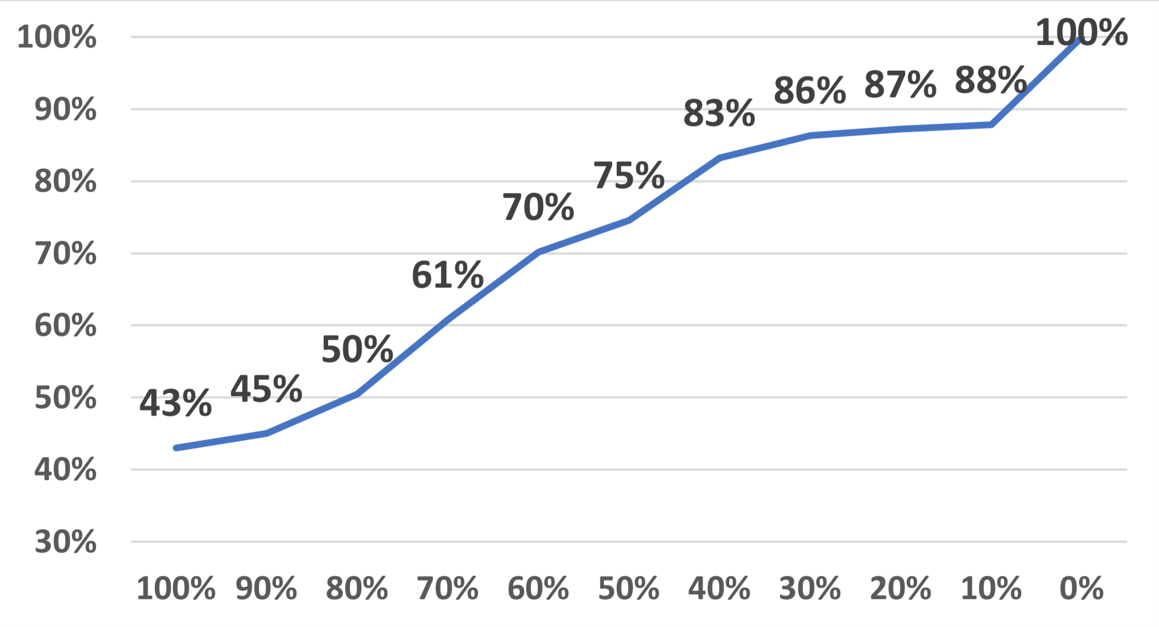
Commonality of Patterns (RQ4)
Developers
Shared Pattern

Slide 56
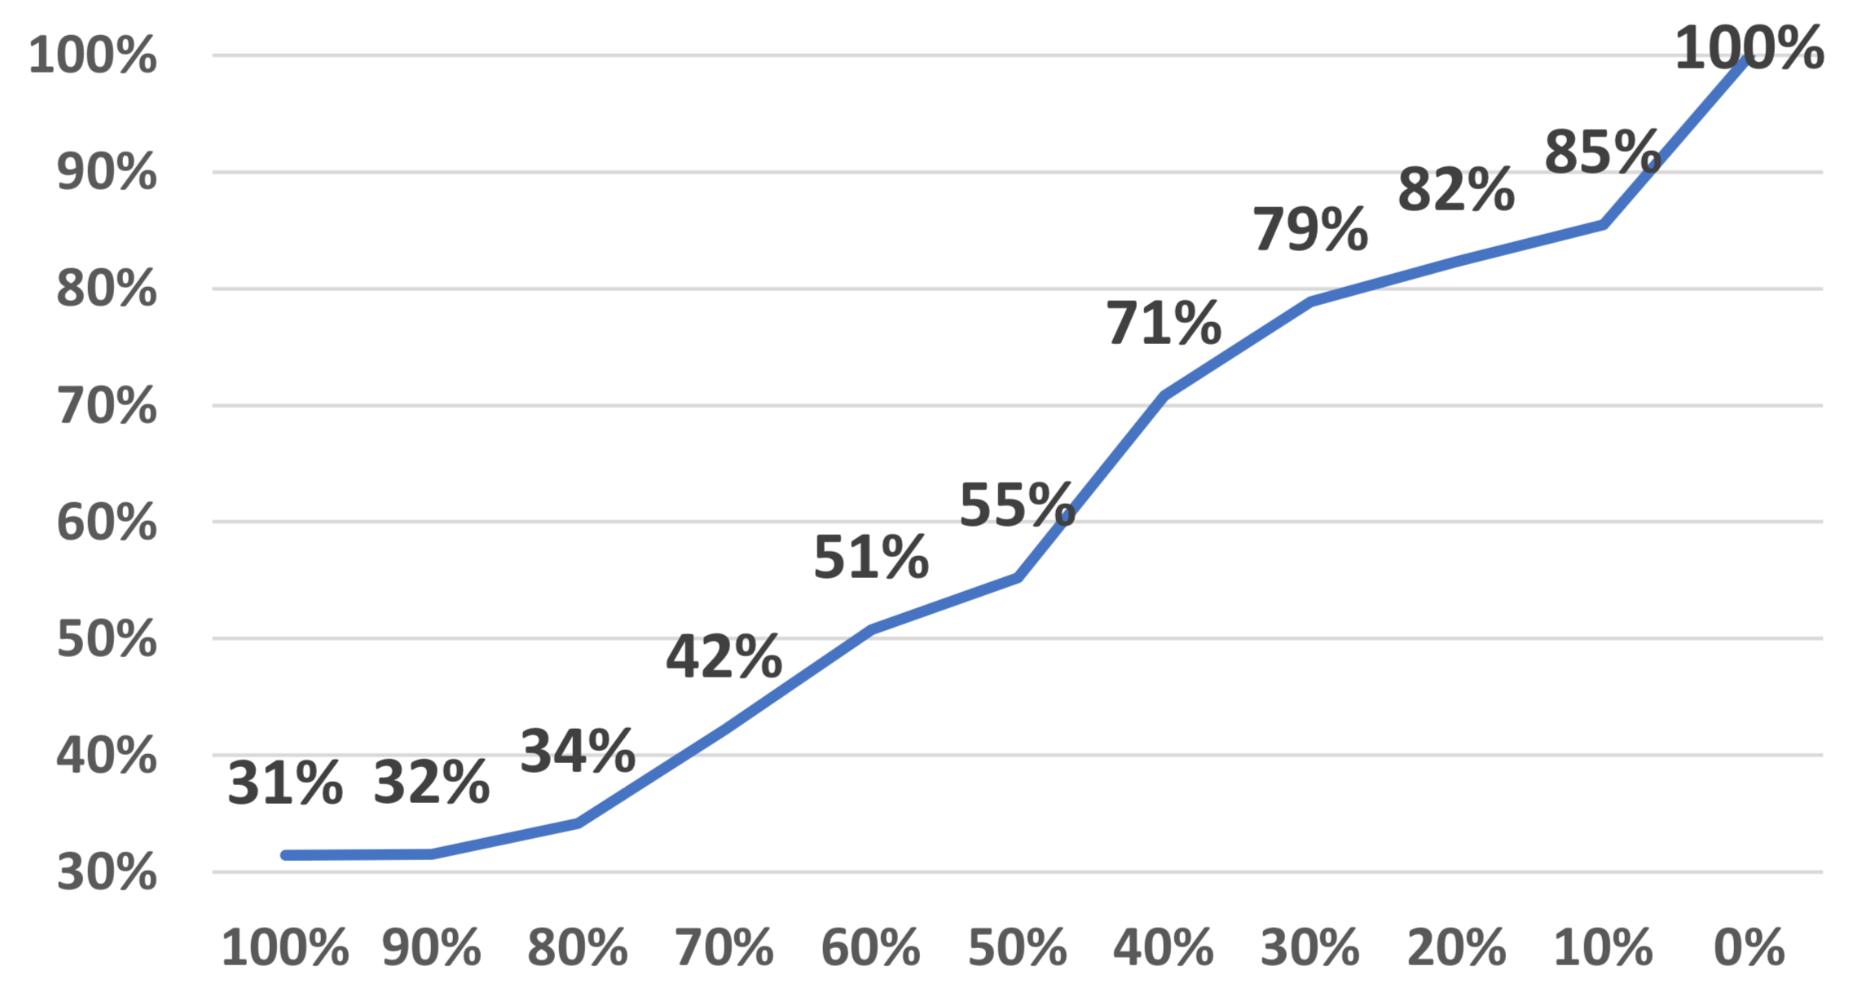
Commonality of Patterns (RQ4)
Projects
Shared Pattern

Slide 57
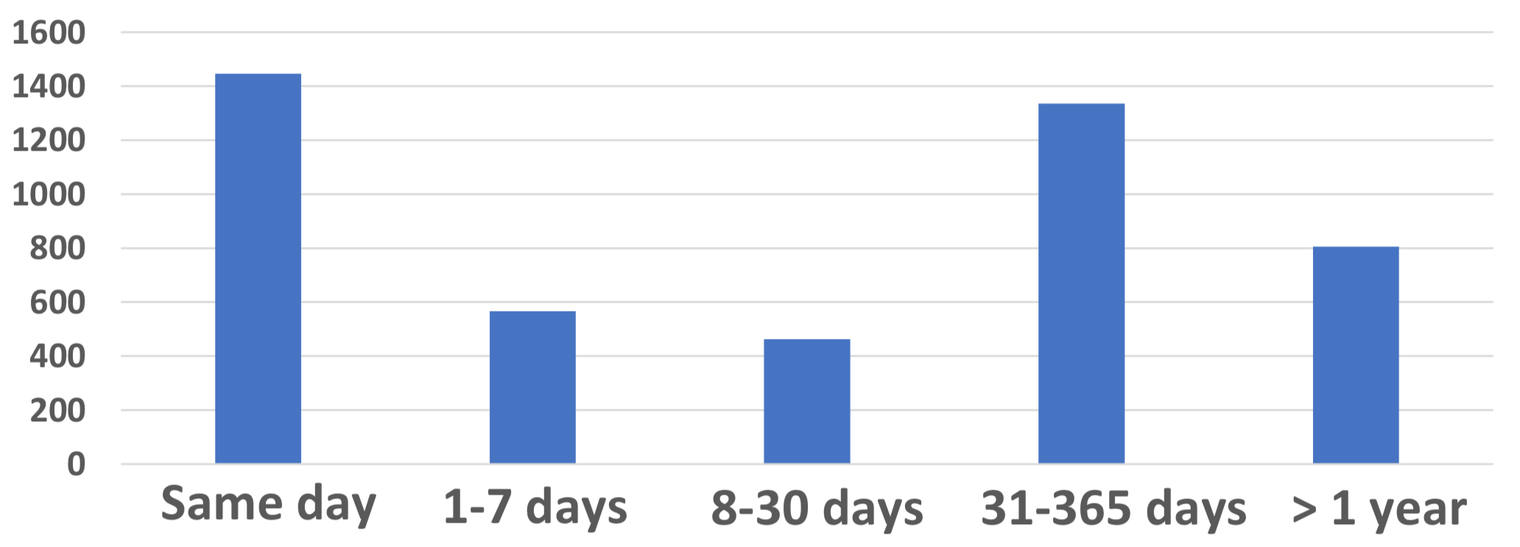
Temporal Distribution of Patterns (RQ5)
Change patterns are pervasive among both time and space
Notes:
Implications

Slide 58
Community-based database
Semantic Change Patterns

Slide 59
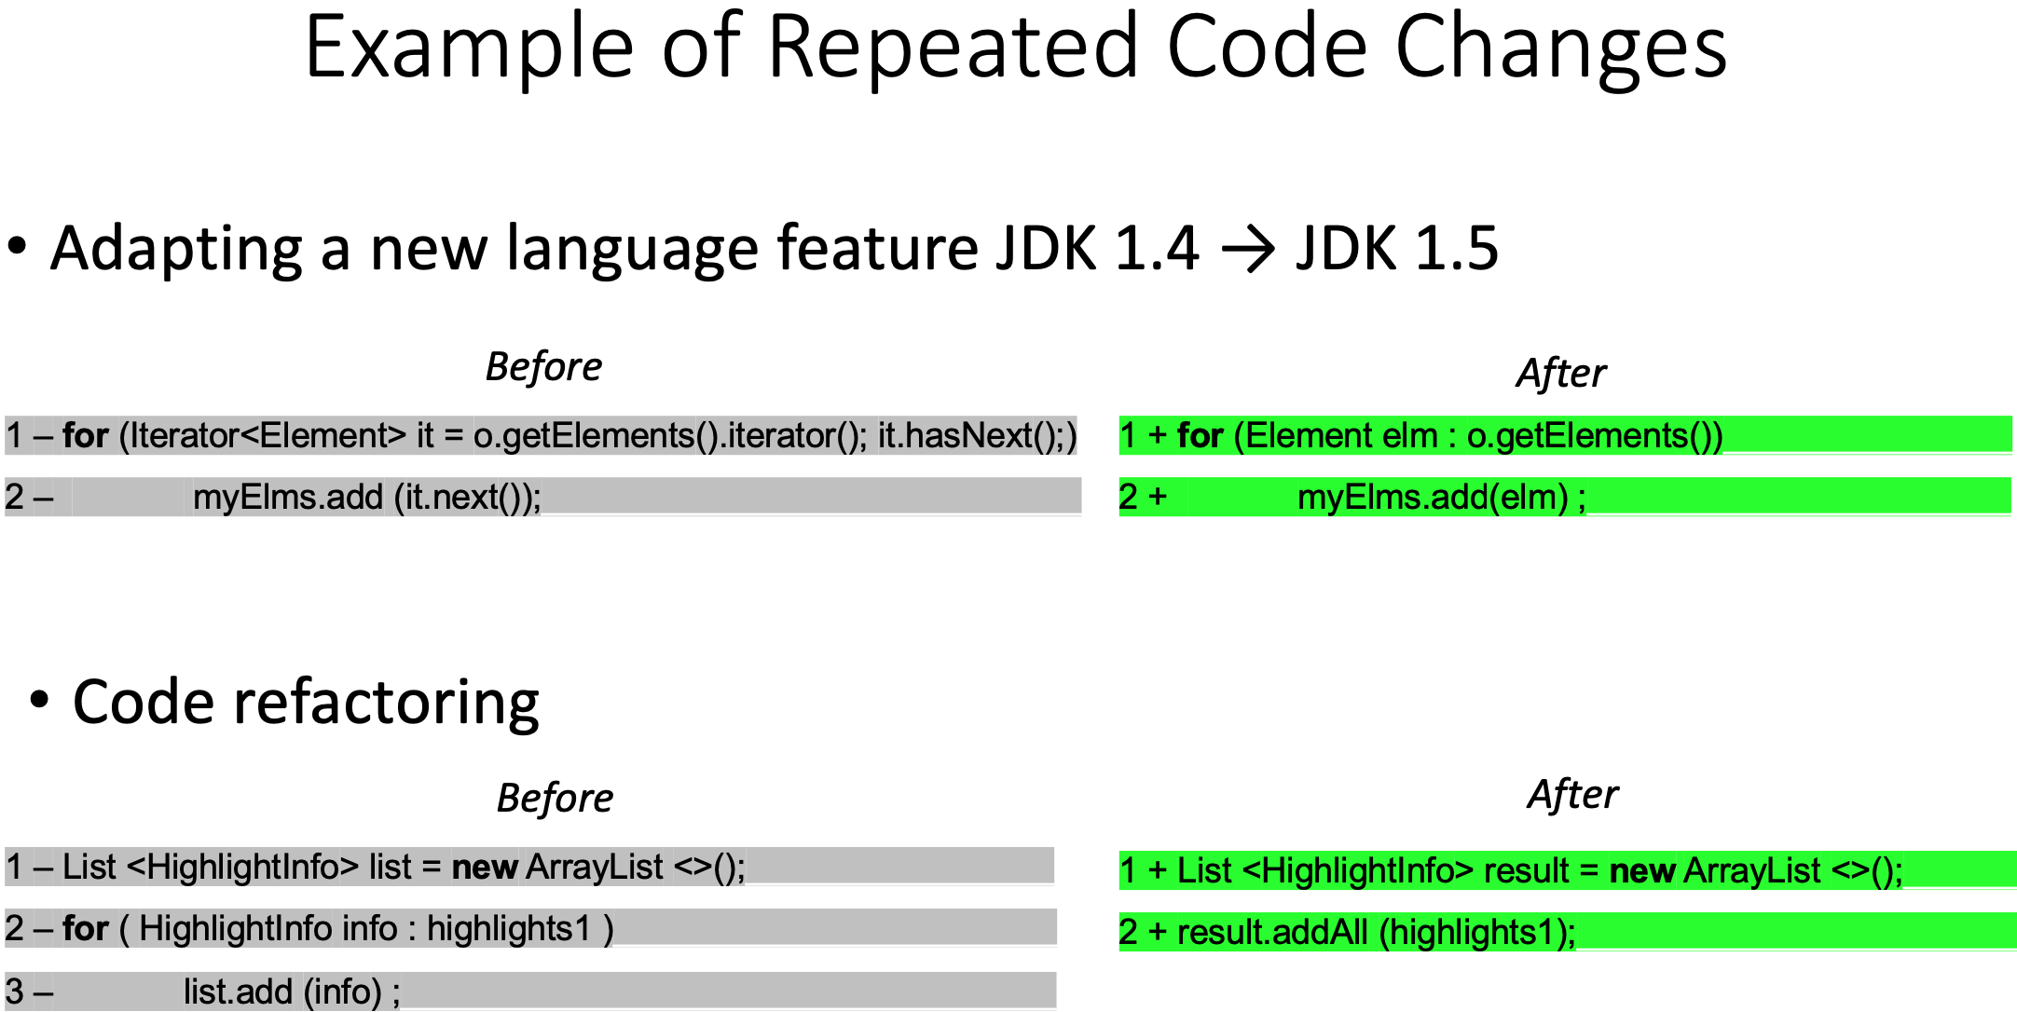
CPatMiner: A Graph-based Approach to Mine Semantic Code Change Patterns
Q1 Is the highlighted change at these lines similar to another in the past?
Yes | No | Not sure |  | No answer
69% | 22% | 6% |  | 3%
Q3 Can you give it a name?
Yes | No |  |  | No answer
79% | 18% |  |  | 3%
Q4 Would you like to have this change automated by a tool?
Yes | No | Not sure | Already Automated | No answer
44% | 34% | 9% | 10% | 3%
A
A’
A
A’
B
C
B
C
Mining frequent subgraphs
Source code
changes
Extracting change graphs
A
A’
B
C
A
A’
A
A’
Pattern
B
C
B
C

